Slide 1
The Merchant of Venice
Answers Act 3

Slide 2
1. What news has Salerio heard on the Rialto?
Antonio has lost a ship at Kent, England.

Slide 3
2. What is the Rialto?
The place where Merchants buy and sell their goods. It is like the Stock Exchange.

Slide 4
3. What does Shylock accuse Solanio and Salerio of?
Shylock says they knew everything about his daughter’s disappearance.

Slide 5
4. What does Shylock want to do with Antonio’s flesh?
Use it as bait to catch fish.

Slide 6
5. What, according to Shylock, makes him also human and gives him the right to be respected?
He has eyes, hands, organs, a body, senses and desires.
He eats the same food as other people.
He is hurt by the same weapons.
He suffers the same diseases, and he is healed like others.
He laughs when tickled.
He bleeds when pricked.
He will die if poisoned.
He will take revenge like every other human.

Slide 7
6. What news did Tubal bring about Jessica?
She spent 80 ducats in one evening.
She gave away a jewel for a monkey.

Slide 8
7. Jessica exchanged a ring for a monkey. Why was this terrible for Shylock?
The ring was given to Shylock by his wife. He would not have given it away for a wilderness of monkeys.

Slide 9
8. Something comforts Shylock despite all Jessica’s spending. What is that?
Antonio seems to be in financial trouble and may not be able to pay his debt.

Slide 10
9. Why does Portia want Bassanio to wait before he chooses a casket?
She does not want to lose his company.

Slide 11
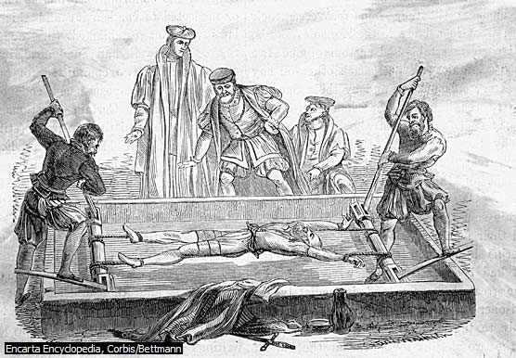
10. What does Bassanio mean when he says he lives upon the rack?
He feels as if he is being tortured when she prevents him from choosing.

Slide 12
11. Why does Portia want music to play while Bassanio is making a choice?
If he chooses wrong he can die like a swan.
If he chooses right the music will play as if he is a new king being crowned or the music will be like the music played under a bridegroom’s window on the morning of the wedding.

Slide 13
12. Why did Bassanio choose the lead casket?
Lead is a dull colour and it does not symbolise the things gold and silver symbolises.

Slide 14
13. How did he have to claim Portia?
With a kiss.

Slide 15
14. Why has Portia bereft Bassanio of all words?
Portia just promised herself and all her possessions to Bassanio.

Slide 16
15 What was Gratiano doing while Bassanio was wooing Portia?
Gratiano wooed Nerissa.

Slide 17
16. What news does Bassanio receive from Antonio?
All his ships wrecked.
His creditors demand payment and Antonio is unable to pay them.
Antonio forfeited the bond with the Jew and must now give a pound of his flesh.
He cleared all debts between him and Bassanio.

Slide 18
17. What truth does Bassanio reveal about himself to Portia?
He has less than no money.
He borrowed money from a friend and endangered that friend’s life in the process.

Slide 19
18. How much money does Portia give Bassanio to pay Shylock?
36 thousand ducats

Slide 20
19. Portia gave Bassanio a ring. What did he have to do with that ring.
He must always keep it on his finger.

Slide 21
20. What is Antonio trying to tell Shylock?
He wants Shylock to give him another chance to pay the money.

Slide 22
21. Why will Shylock not listen to Antonio?
Shylock has sworn an oath that he would take the flesh.

Slide 23
22. Why does Shylock hate Antonio?
Antonio has paid the debts of people that could not pay Shylock and in that way Shylock lost a lot of profit.

Slide 24
23. Why will the Duke not let Antonio go free without honouring the bond?
It will influence the whole law of Venice.
The law must be firm or everybody will try to get their contracts cancelled.

Slide 25
24. What does Portia tell Lorenzo about where she is going?
Portia says she is going to a monastery to pray until Bassanio returns.

Slide 26
25. What letter does she send to Dr. Bellario?
The letter asks for notes and clothing.

Slide 27
26. Why would their husbands not recognise them?
They will be dressed like men.

